Slide 1


Data-Driven Healthcare
STROKE PREDICTION
Analyzing and predicting the likelihood of a person having a stroke in the future through advanced clinical models.
Presented by: KRISHNAPRIYA K D
Notes:
1

Slide 2


Introduction
What is Stroke Prediction?
Stroke prediction is the process of analyzing a person's complex health and lifestyle data to estimate their future risk of experiencing a cerebrovascular accident (stroke).
Data Analysis
1
Collecting and processing clinical records, demographic information, and lab results.
Risk Assessment
2
Using machine learning models to quantify individual risk and susceptibility.
Preventive Care
3
Enabling physicians to implement targeted interventions for high-risk patients.
Notes:
2

Slide 3




Why Predictive Modeling is Critical
Implementing stroke prediction systems provides substantial benefits across patient care and public health management.
Early Intervention
Reduce Mortality
Allows for timely preventive actions like medication or lifestyle changes to avert a stroke.
A proactive approach significantly reduces the fatality rate associated with stroke events.
Prevent Disability
Health Planning
Minimizing stroke incidence prevents long-term neurological damage and disability.
Supports effective allocation of healthcare resources and targeted public health campaigns.
Real-world Relevance: Stroke prediction systems enable early risk detection, preventive healthcare, efficient resource management, and improved patient outcomes globally.
Notes:
3

Slide 4

Project Rationale
Addressing the Detection Challenge
The Problem Statement
Project Objective
Early and accurate detection of stroke risk is challenging due to the intricate interplay of multiple health and lifestyle factors.
To analyze extensive patient health data and develop a high-accuracy machine learning model that predicts the likelihood of stroke, facilitating early intervention and preventive care pathways.
Manual, traditional assessment methods are often time-consuming, prone to human error, and struggle to accurately quantify complex risks.
There is a critical need for a robust, objective, and automated predictive system to analyze patient data, identify high-risk individuals, and enable timely intervention.
Notes:
4

Slide 5

Project Goals and Scope
Our primary goals focus on leveraging data science to create a practical, high-impact clinical tool.
Identify Key Risk Factors
1
Determine which clinical and demographic variables are the most significant predictors of stroke occurrence.
Develop Accurate Model
2
Build and validate a robust machine learning model using advanced classification techniques.
Provide Actionable Insights
3
Generate clear data visualizations and predictive dashboards for easy integration into clinical decision-making processes.
Notes:
5

Slide 6

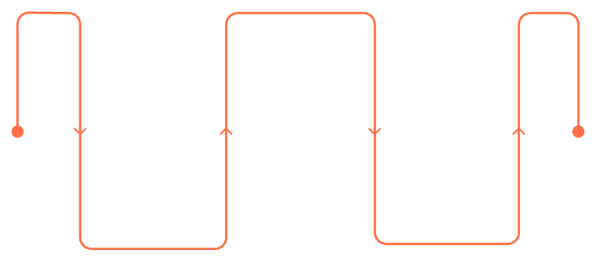



Data Source
Dataset Overview: Stroke Prediction
The model training was based on a comprehensive dataset capturing various patient attributes relevant to stroke risk.
Data Preparation
Source
Cleaning and feature engineering
Kaggle community dataset.
Total Records
Model Training
5,110 patient records for training and validation.
Data Acquisition
Train classification models
Source: Kaggle community dataset
Target Use
Classification task to predict binary stroke occurrence.
Notes:
6

Slide 7

Key Features in the Dataset
The predictive model utilizes a range of categorical and numerical features to assess patient risk.
Age
Numerical age of the patient (Continuous).
Hypertension
Binary indicator (0=No, 1=Yes).
Heart Disease
Binary indicator (0=No, 1=Yes).
Avg Glucose Level
Blood glucose measurement (Continuous).
BMI
Body Mass Index (Continuous).
Smoking Status
Categorical: Formerly smoked, smokes, never smoked, unknown.
Work Type
Categorical: Private, Self-employed, Govt Job, Children, Never Worked.
Target Variable: Stroke
Indicates whether a patient has experienced a stroke (1 = Stroke, 0 = No Stroke). This is the variable the models were trained to predict.
Notes:
7

Slide 8


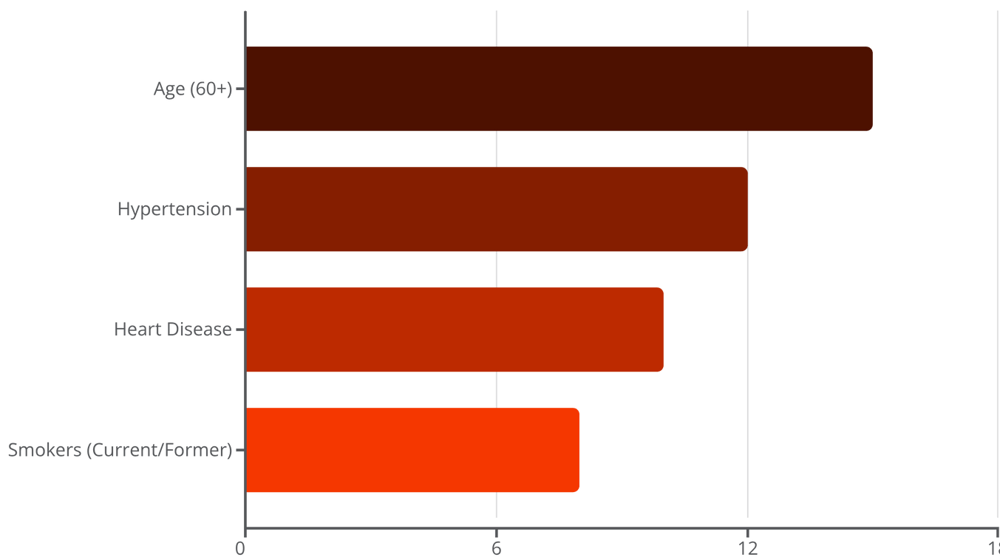
Data Insights
Exploratory Data Analysis (EDA) Visuals
Initial analysis revealed significant relationships between risk factors and stroke incidence, particularly regarding data imbalance.
Age Factor
Hypertension Link
Smoking Risk
Older patients show a notably higher proportion of stroke cases, indicating age as a dominant risk factor.
The incidence of stroke is significantly elevated in patients who report having hypertension.
Former and current smokers exhibit a higher frequency of stroke events compared to non-smokers.
Notes:
8

Slide 9
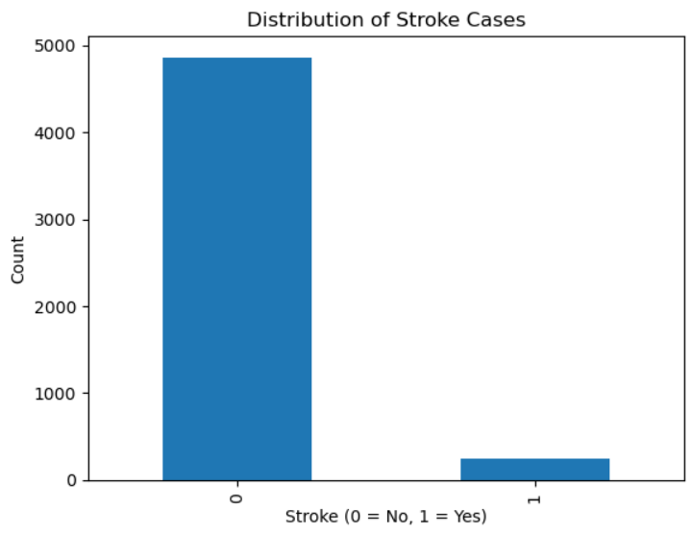

Slide 10
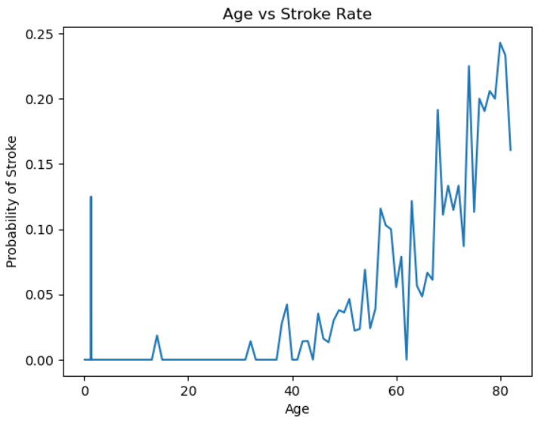

Slide 11
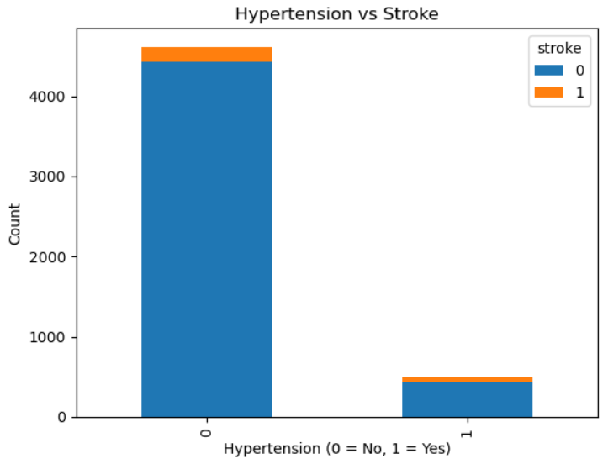

Slide 12
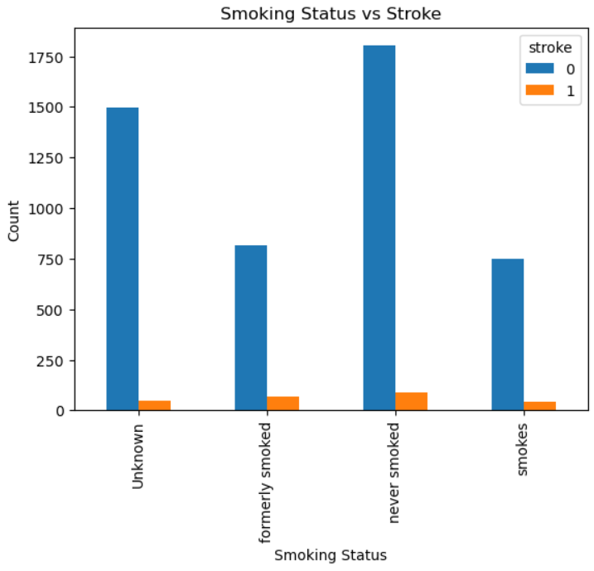

Slide 13
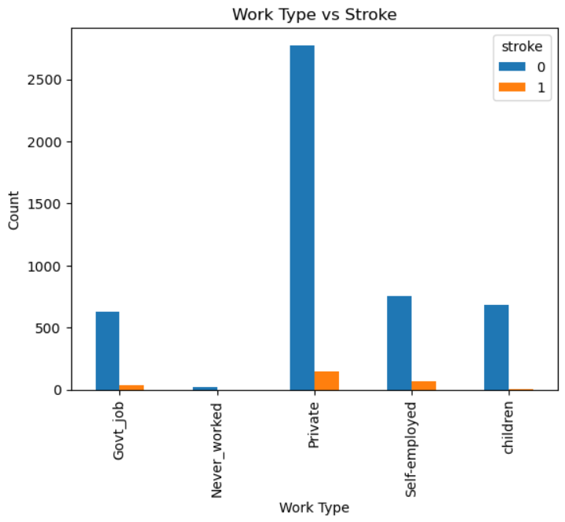

Slide 14
Model Comparison and Results
We tested three distinct classification models to determine the optimal algorithm for stroke prediction.
Models Applied
Best Model Performance
Logistic Regression
95%
94%
Used as a baseline for its simplicity and interpretability in binary classification tasks.
Accuracy
Precision
Random Forest Classifier
Effective in handling non-linear relationships, complex feature interactions, and avoiding overfitting.
92%
93%
Gradient Boosting Classifier
Recall
F1-Score
Provides robust predictive performance through sequential ensemble learning, aiming for low bias.
The Random Forest Classifier achieved the highest balance of metrics, demonstrating superior predictive power.
Notes:
14

Slide 15
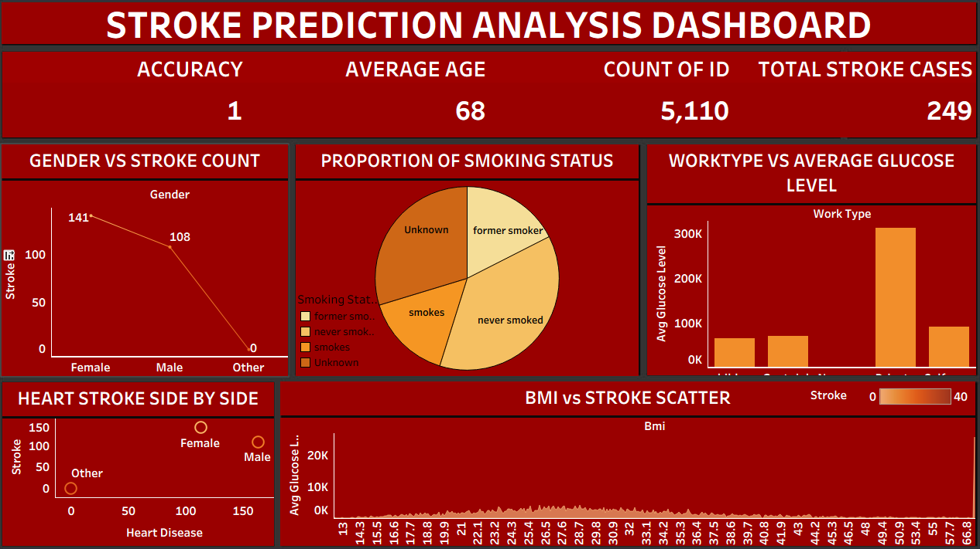
TABLEAU DASHBOARD

Slide 16
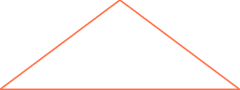
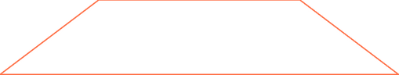



Conclusion: Key Drivers of Stroke Risk
The model training confirmed that both non-modifiable and lifestyle factors are critical inputs for accurate risk prediction.
1
Age
2
Glucose Level
3
Hypertension / Heart Disease
4
Smoking Status
These features emerged as the top five most impactful variables in determining stroke likelihood within the Random Forest model.
Notes:
16

Slide 17

THANK YOU!
We appreciate your time and interest in our predictive modeling for stroke risk. For further inquiries or to explore potential collaborations, please feel free to reach out.
Notes:
17

